Slide 1
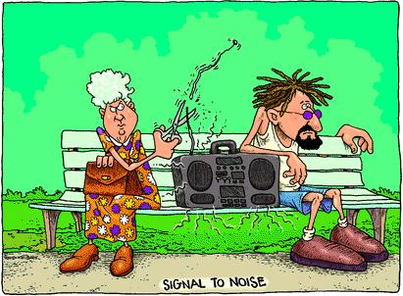

Slide 2
Popcorn 1969
http://www.youtube.com/watch?v=OSRCemf2JHc
Frist computer synthesia song.

Slide 3
Quiz
Did you read the lab
What is mean by the word “POT”
What are Schmitt trigger used for?

Slide 4
Lab 7 Schmitt Trigger
Objectives
Lean and demonstrate the design of a Schmitt trigger circuit.
Discuss the differences between a Schmitt Trigger and Comparator.
Create a clock signal (square wave) from a sin wave.

Slide 5
New concept
The humble potentiometer (or pot, as it is more commonly known) is a simple electro-mechanical transducer. It converts rotary or linear motion from the operator into a change of resistance, and this change is (or can be) used to control anything from the volume of a hi-fi system to the direction of a huge container ship.

Slide 6
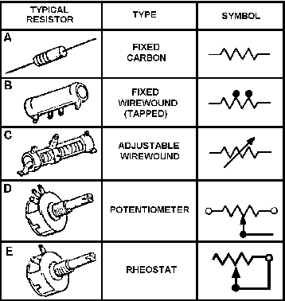
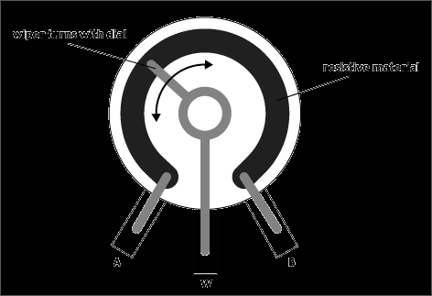
Potentiometer (Pot)

Slide 7
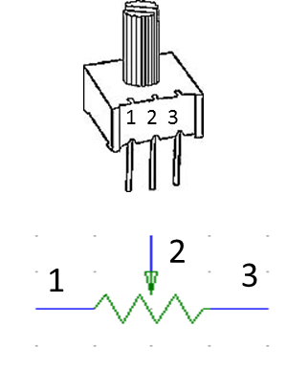

Slide 8
From last week lab, you leaned that a comparator works by taking the two inputs and subtracting the inputs from one another to give an output voltage. (The difference between the inputs)

Slide 9
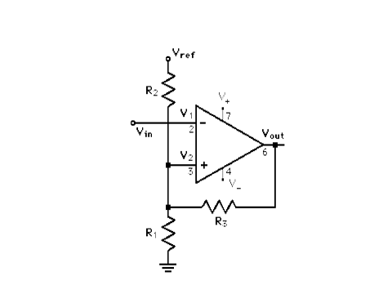
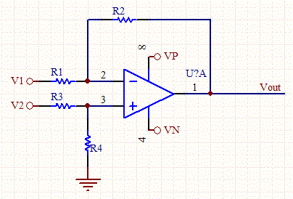
Comparator VS Schmitt

Slide 10
Definition
The Schmitt trigger is an application which switches the output negative or positive when the input passes upward/ downward through a positive / negative reference voltage. It then uses negative feedback to prevent switching back to the other state until the input passes through a lower threshold voltage, thus stabilizing the switching against rapid triggering by noise as it passes the trigger point.

Slide 11
Lets look at a wave form and compare the outputs as a comparator VS a Schmitt.

Slide 12
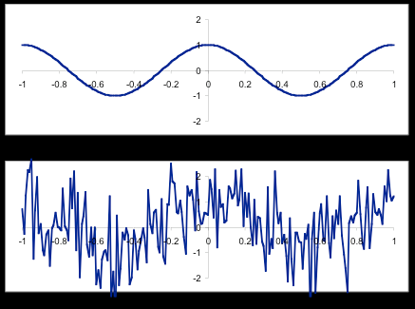

Slide 13
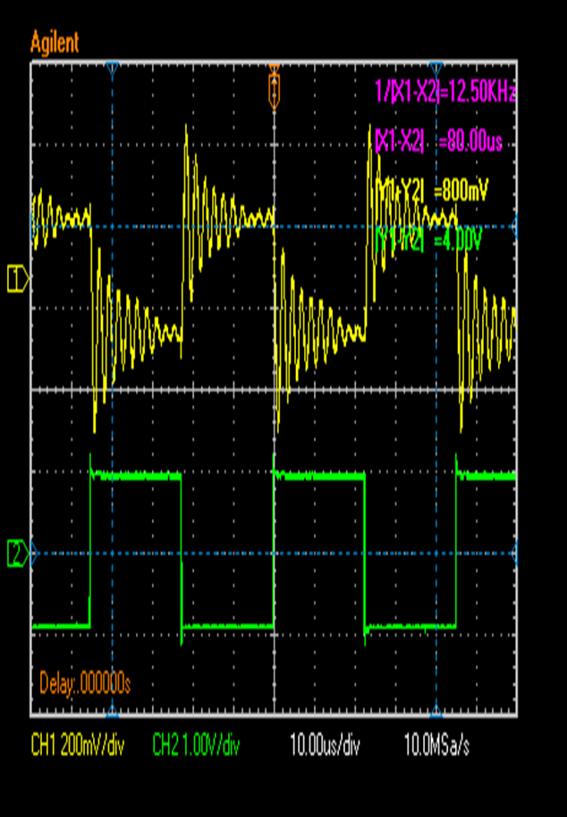

Slide 14
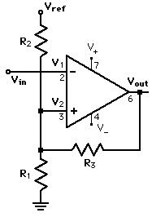

Slide 15
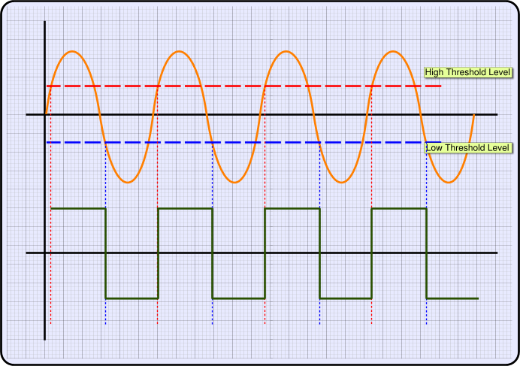

Slide 16
The Value chosen for R1, R2 and RF depend on the desired values for refV turn on and the saturation voltage of the output. Looking at the data sheet for LF347 peak to peak swing of 32 volt with a load resistor of 10k and supply voltage of +- 18. We ignore the three volt difference and assume output saturates at the supply voltage.

Slide 17
+V trigger = voltage divider (both +Vt and –Vt are chosen by you) of R1 and R2
–V trigger = Vref ÷ R1//R2 + R3 = -Vt

Slide 18
Pin-outs just another word for chip layout.

Slide 19
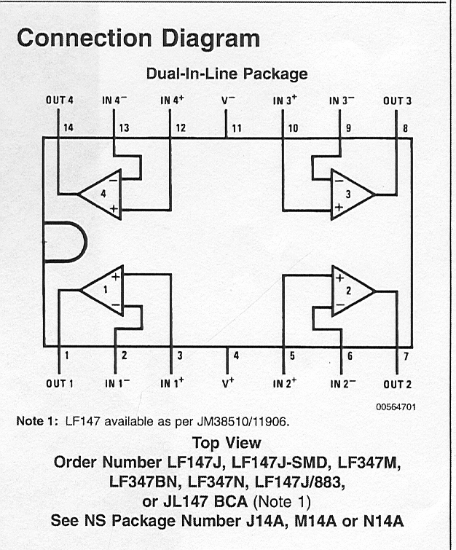
Change pinouts to match diagram

Slide 20
Duty cycle
Is the time the output is high VS low.
20% duty cycle is 20% on and 80% off
80% duty cycle is 80% on and 20% off

Slide 21
Changing the Duty Cycle
How would you change the duty cycle?
Trigger voltage?

